Slide 1
Employee Management
Team B
Name : Gaurav Chaudhary
Employee code : 200766

Slide 2
What is Employee Management System?
1 - It is database to store the employee information.
2 - In it we efficiently manage our employee information, like adding, deleting updating displaying employee information.
3 - Technology stack used is C language and file handling to store the information approach.

Slide 3
Important Functions :-
1 - Add Employee - void addEmployee()
2 - Delete Employee - void deleteEmployee()
3 - Update Employee - void updateEmployee()
4 - List All Employee - void displayEmployee()
5 - Display Employee with Employee Code - void displayEmployeeInfo()

Slide 4
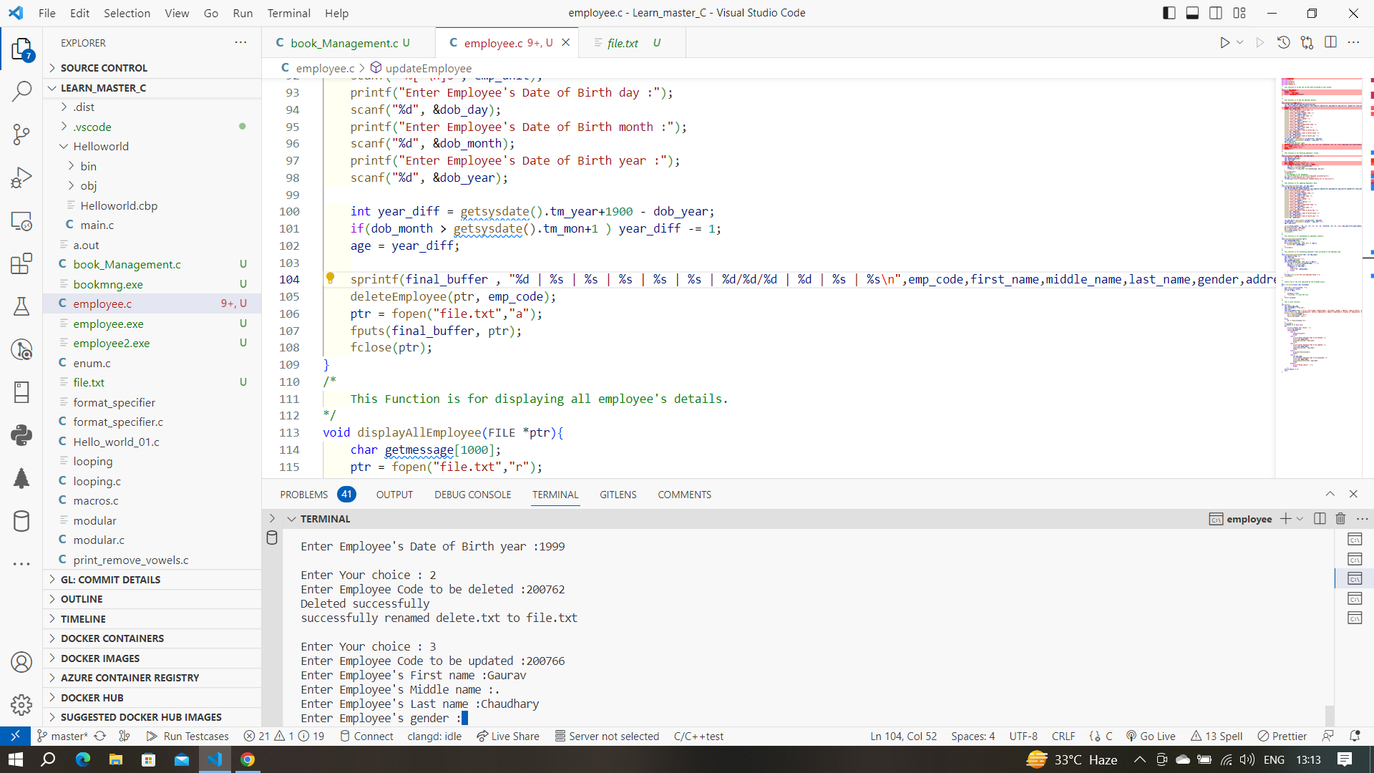

Slide 5
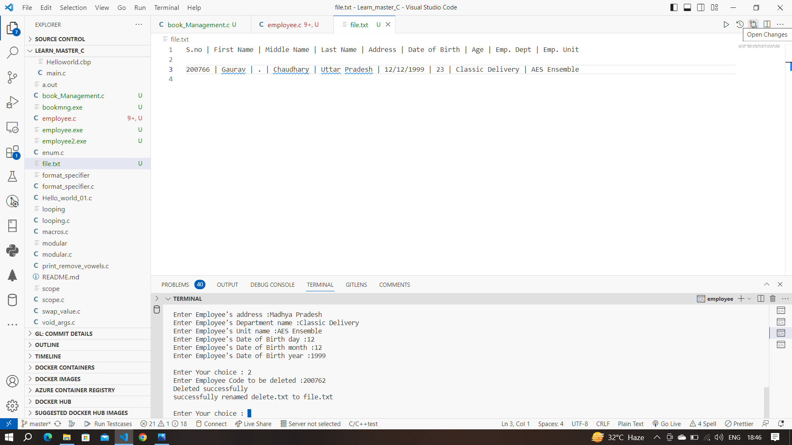

Slide 6
Thank You

